Slide 1
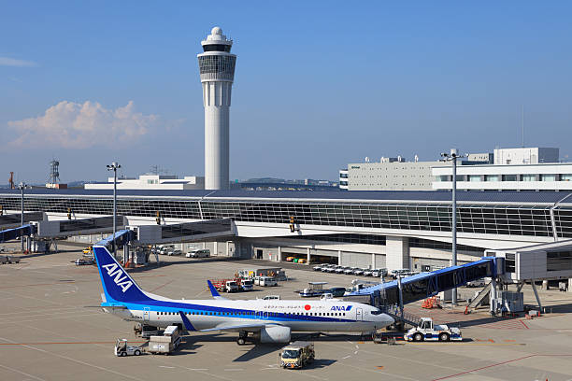
Airport Data Analysis: (Excel)

Slide 2
AIRPORT DATA ANALYSIS: (EXCEL)

Slide 3

INTRODUCTION
The aviation industry plays a pivotal role in global connectivity, economic development, and regional accessibility. Airports, as central hubs in this ecosystem, generate vast volumes of data daily-from passenger traffic and flight schedules to cargo handling and operational efficiency.
Analyzing this data is crucial for airport authorities, airline operators, government bodies, and other stakeholders to make informed decisions, improve performance, and enhance passenger experience.
This project focusses on the airport data analysis using Microsoft Excel, leveraging the software’s powerful data manipulation and visualization capabilities to uncover key insights.

Slide 4

Objectives
Identify trends in Passenger and flight volume over time.
Understand seasonal fluctuations and peak travel periods.
Examine on-time performance and delay patterns.
Analyze the relationship between various airport operations.
Provide actionable insights to improve airport efficiency and resource allocation.

Slide 5

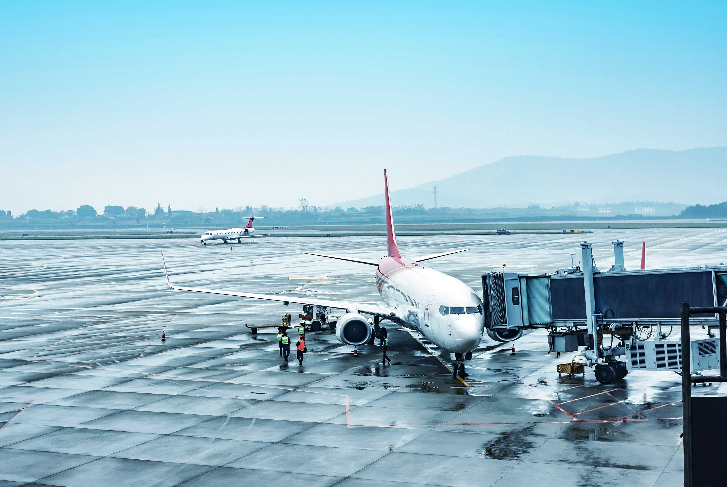
Requirements
Microsoft Excel (2016 or later):
For data entry, analysis, and visualization.
Computer/Laptop:
Minimum 4 GB RAM (8 GB recommended).
Sufficient storage for data files.
Airport Dataset (Should Include):
Flight details (arrival/ departure times, delays).
Passenger statistics.
Airline and airport codes
Cargo volume (if applicable).
Domestic and international routes.

Slide 6
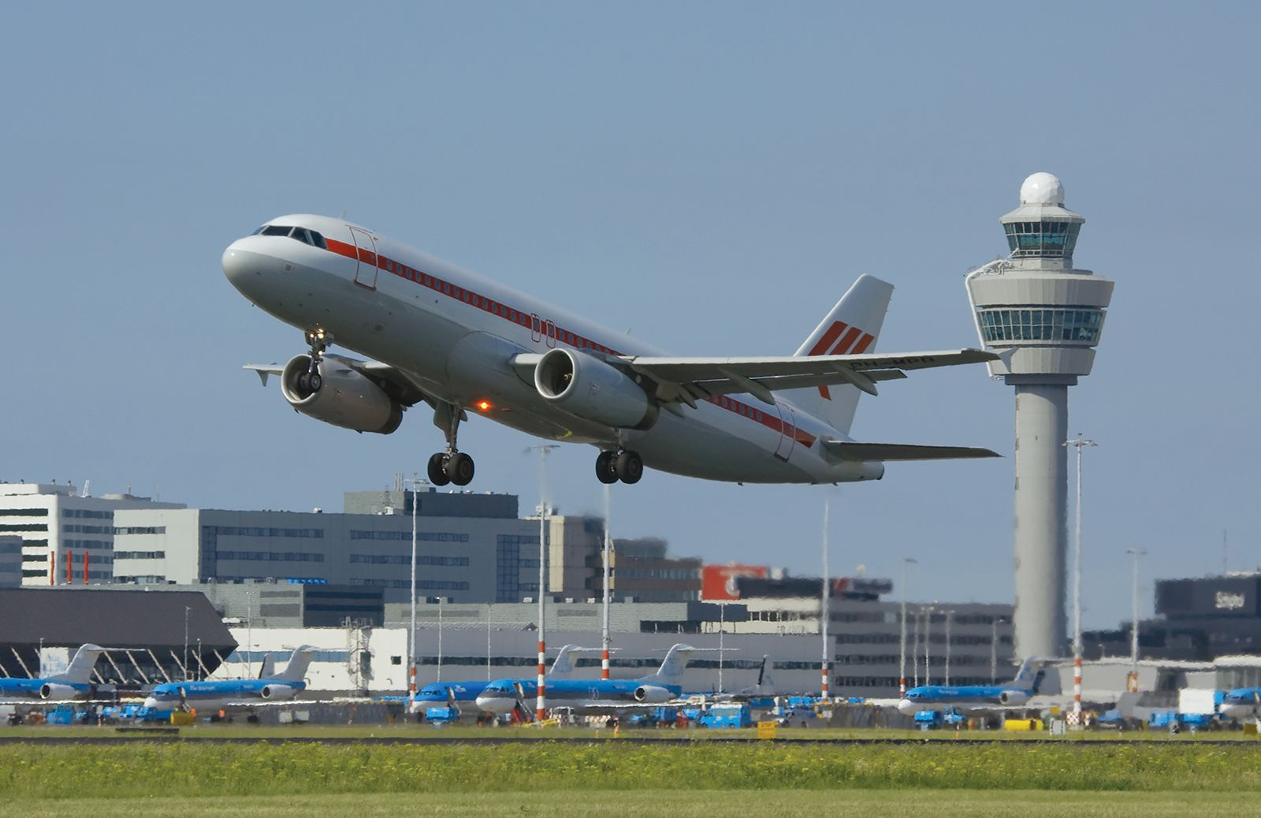
Excel Skills:
Data cleaning (remove duplicates, handle blanks)
Formulas (SUMIFS, IF, VLOOKUP/XLOOKUP, etc.)
pivot Tables and Pivot Charts
Conditional Formatting
Dashboard Creation
Analytical Skills:
Trend identification.
KPI analysis (e.g., flight punctuality, traffic growth)
Data-driven decision making

Slide 7

ANALYSIS

Slide 8
01
Ratings Analysis

Slide 9
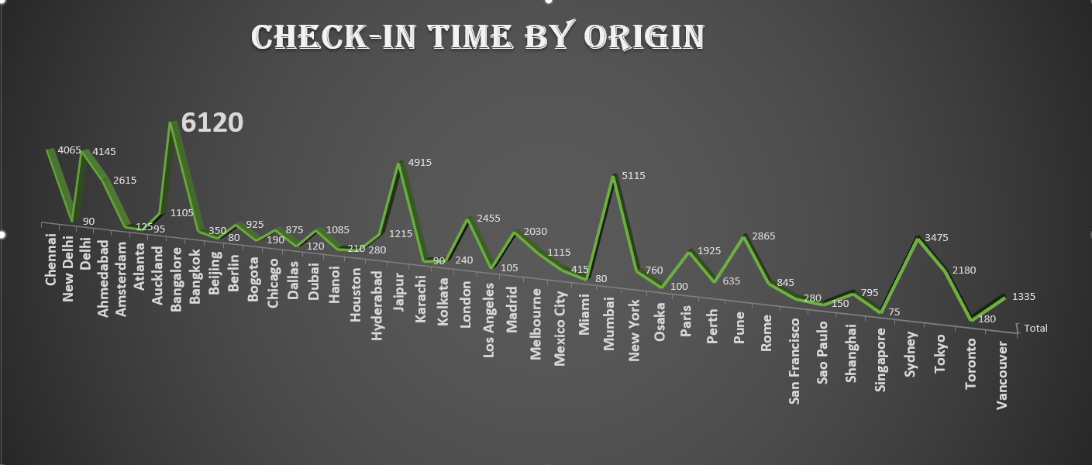
Check-in Time By Origin:
We have analyzed the check-in-time as per the ratings.
Here we could notice that every states have origin.
Here check-in-time is more in Bangalore, means Bangalore have taken more time for checking as per the passenger's review.

Slide 10
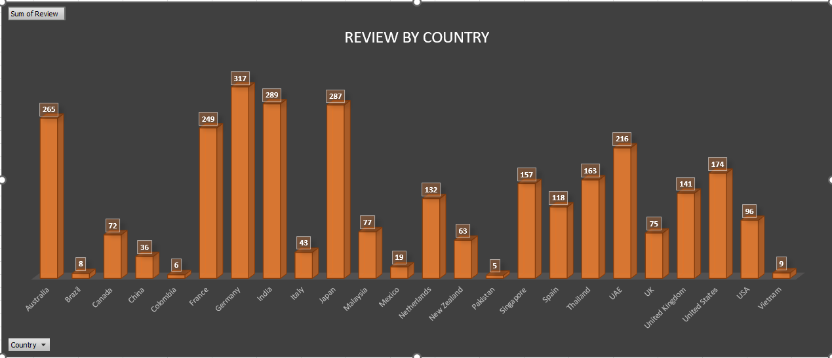
Review By Country:
We have analyzed the review by country as per the ratings.
Here we have analyzed review by each country as per each passengers provided.
According to them most of review have provided by Germany country.

Slide 11
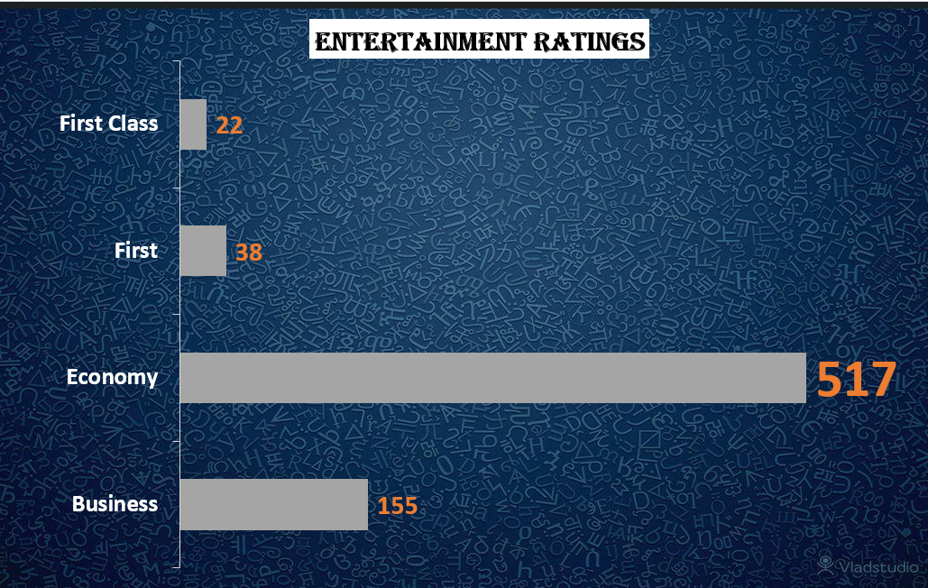
Entertainment Ratings:
We have analyzed the Entertainment Ratings as per the ratings Analysis.
Here airlines have many refreshments for passengers.
There is entertainment ratings provided by many passengers according to class wise here economy class passengers have provided more ratings.

Slide 12
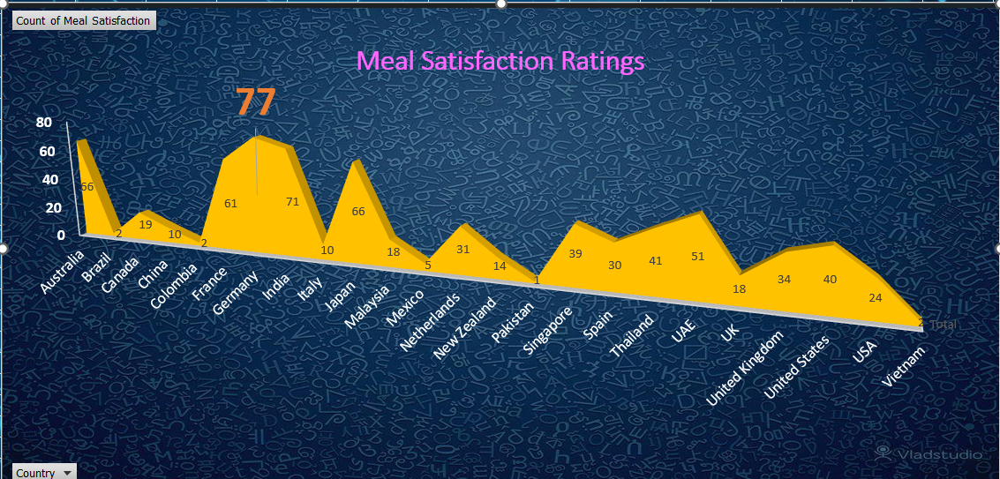
Meal Satisfaction Ratings:
We have analyzed the meal satisfaction ratings as per the ratings analysis.
Every flights provides meals as per passengers have provided meal ratings .
Germany country have provided most ratings for meal.

Slide 13
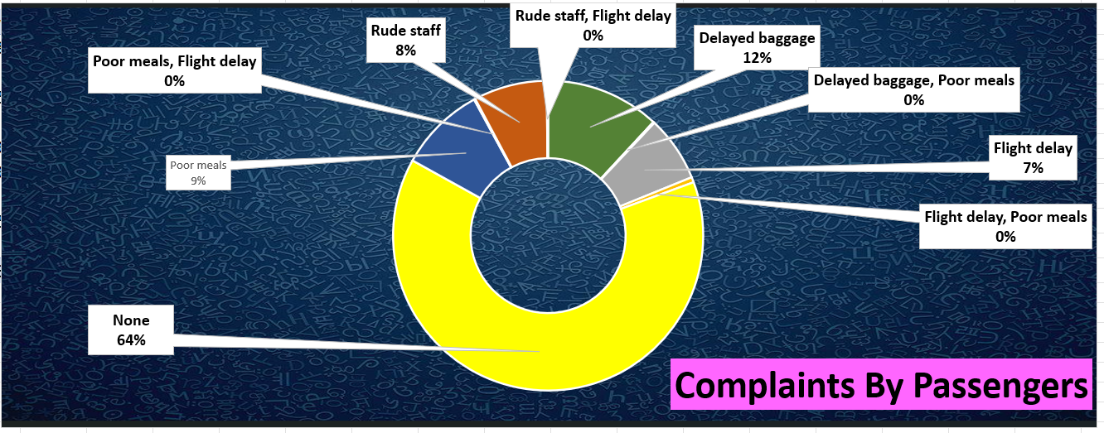
Complaints By Passengers:
We have analyzed the complaints by passengers as per the ratings.
Each and every where complaints will be risen those complaints are analyzed for better results.
Here passengers travelled have provided many complaints.
But here many passengers have provided complaints as none.

Slide 14

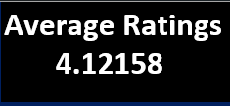
s

Slide 15
02
Airport Overview Analysis

Slide 16
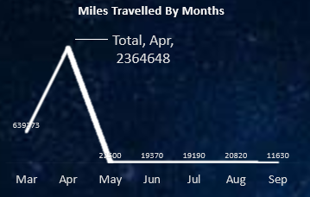
Miles Travelled By Months:
We have analyzed the Miles Travelled By Months as per the overview analysis.
Many passengers have travelled through different countries and they have covered many miles.
As per month wise analysis to know which month the flight have covered many distance, we got April month have covered more distance.

Slide 17
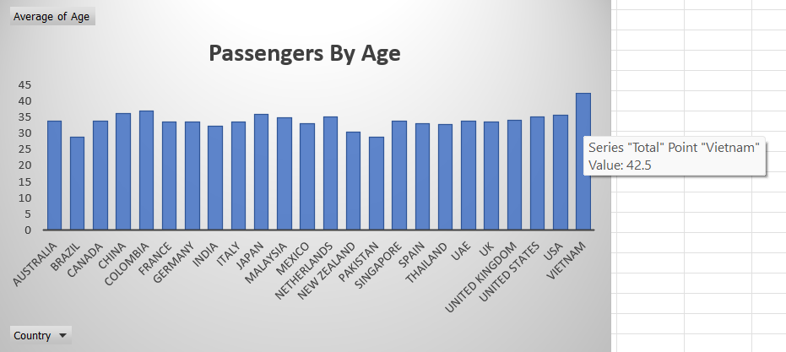
Passengers By Age:
We have analyzed the Passengers By Age as per the overview Analysis.
While we come to analyze the passengers as per age, we have analyzed in each country average of age peoples have travelled.
In Vietnam country 42.5 average age passengers have travelled and it is most highest age passengers travelled while compare to other country.

Slide 18
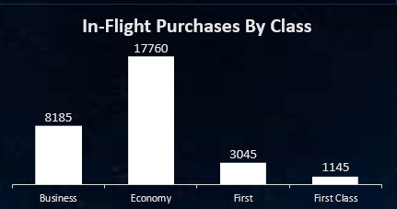
In-Flight Purchases By Class:
We have analyzed in-flight purchases by class as per the overview analysis.
Passengers travel may depend on their tastes and preferences as per flight data some passengers have travelled in business, economy, first, first class.
Many passengers have made purchases as per classes they travelled.
Here in economy class passengers have made more purchases.

Slide 19
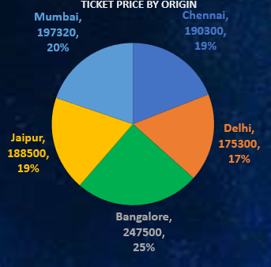
Ticket Price By Origin:
We have analyzed the ticket price by origin as per the overview analysis.
Passengers who have travelled from origin(city) they will pay for tickets.
Here from origin analysis as per ticket prices in Bangalore city more ticket price have collected.

Slide 20
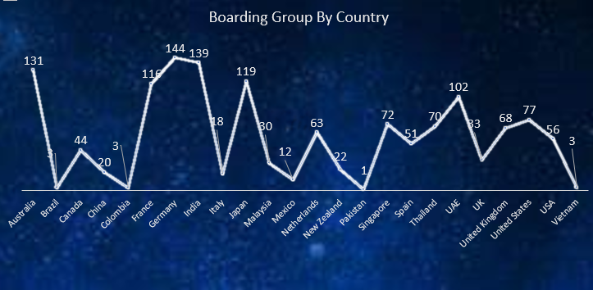
Boarding Group By country:
We have analyzed the Boarding Group By Country as per the overview analysis.
Every country have boarding groups as per our analysis we noticed which country have highest boarding groups.
Here Germany country has highest boarding groups than compare to other countries.
And here we could clearly clarify that in Germany country many passengers will travel and ticket price collected also more.

Slide 21
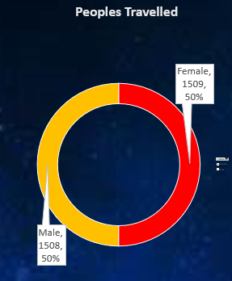
Peoples Travelled:
We have analyzed the Peoples travelled as per the overview analysis.
As per male and female category we have analyzed that how much men and women have travelled in flights.
Here we clearly noticed that male-1508, female-1509.
Female percentage are more than male.

Slide 22



s

Slide 23
Dashboard Analysis

Slide 24

Ratings Dashboard Overview:
in this dashboard session we covered Every Ratings and Reviews Provided By Passengers.

Slide 25
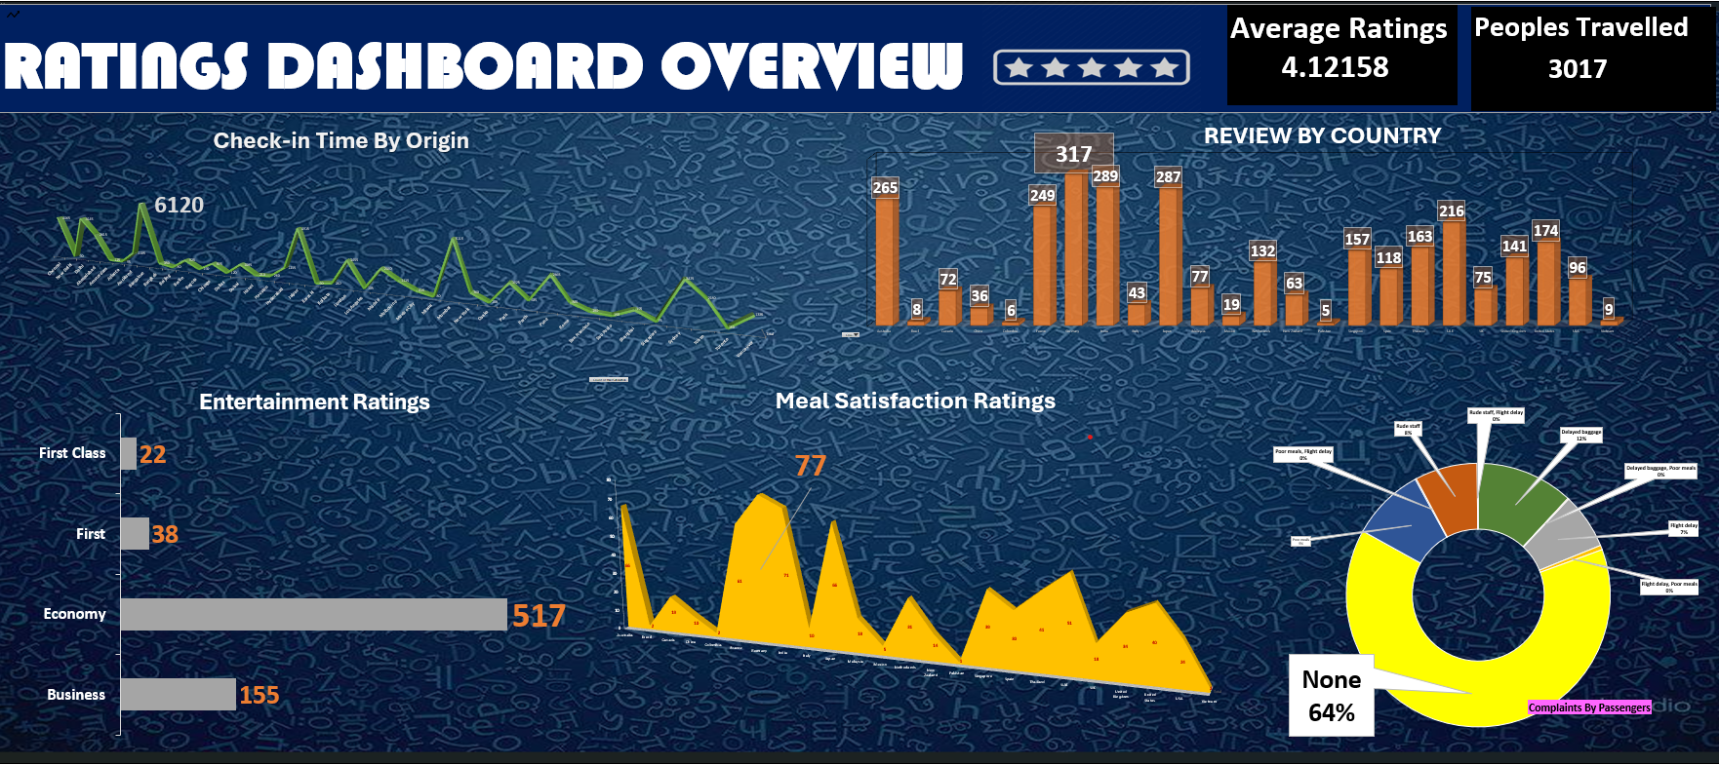

Slide 26
Ratings Dashboard Overview Explanation:
The flight dataset includes ratings as it is most important part for understanding the passenger's preferences and tastes.
As per ratings we analyzed each and every category of ratings provided by every passengers.
So, by going through different calculations, we tried to analyze the best solution.
And for more detailed understanding we visualized those calculations into different charts as suitable, to make users quickly and easily understand the different category of ratings.
Finally, we created dashboard for even better understand of every category at same place.

Slide 27
Airport Dashboard Overview:
in this dashboard session we covered Every sessions and we made easy visualizations of every category in one place for better understand.

Slide 28
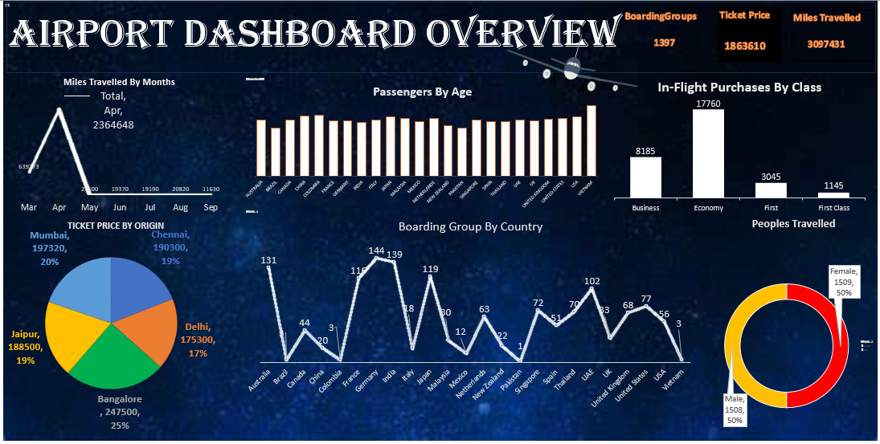

Slide 29
Airport Dashboard Overview Explanation:
Here next, we analyzed after ratings dashboard is overview dashboard
In this dashboard we covered entire things like miles travelled, passengers by age, etc.…
As per this analysis we clearly noticed that how many passengers have travelled by age, gender.
Here in this analysis, we clearly understood that what specifications that every passengers wish to have in future travelling.
With the help of this we can clearly make further decisions and improvements.

Slide 30

CONCLUSION:
The airport data analysis conducted using Microsoft excel has provided valuable insights into the operational performance and passenger trends of the airport.
By organizing and visualizing key data points such as flight movements, passenger volumes, and delay patterns, we were able to identify important trends, seasonal fluctuations, and requiring operational improvements.
Excel’s powerful tools like Pivot Tables, Charts, and advanced formulas enabled efficient data handling and clear representation of findings.
Through this analysis, Key performance indicators (KPIs) such as on-time Performance, traffic growth, and airline efficiency were successfully evaluated, offering data-driven recommendations for enhancing airport operations.
Overall, the analysis highlights the importance of regular data monitoring in the aviation sector to support strategic planning, improve passenger experience, and optimize resource management.
With continuous updates and deeper analytics, airports can further refine their operations and adapt to changing demands in the aviation industry.

